Slide 1
Entity Framework in the Enterprise
St. Louis Days of .NET 2013

Slide 2


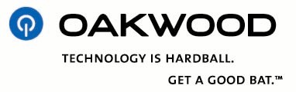


















































Platinum Sponsors
Gold Sponsors
Silver Sponsors

Slide 3

Contact Info
Scott Kuhl
@scottkuhl
geekswithblogs.net/scottkuhl
US Bank Community Development Corp.
usbank.com/cdc
Source & Slides
http://sdrv.ms/1bku4ce

Slide 4
Contoso University
Based on MVC 5 and EF5
http://www.asp.net/mvc/tutorials/getting-started-with-ef-5-using-mvc-4
MVC 5 and EF6 (not complete)
http://www.asp.net/mvc/tutorials/getting-started-with-ef-using-mvc
Sorting, Filtering, Paging
Concurrency
Inheritance
Repository and Unit of Work
Raw SQL Queries

Slide 5
Database and Tools
SQL Server DATA Tools & Entity Framework Power Tools

Slide 6
Microsoft SQL Server Data Tools
http://msdn.microsoft.com/en-us/data/tools.aspx
Source Control
Reverse Engineering
Data and Schema Migration
Schema Compare
LocalDB for Development
Resetting Data to a Common Start
Loading Test Data
Post Deployment Execution
Disable EF Migrations
Startup
Days of .NET Session
Starting with Code-First Entity Framework 10:20 AM Saturday, Level 100
Notes:
DEMO: Reset.sql, TestData.sql, Script.PostDeployment.sql, Global.asax > Application_Start, Database Properties > Debug, Set as Startup and Debug, SQL Server Object Explorer, Schema Compare for production.

Slide 7
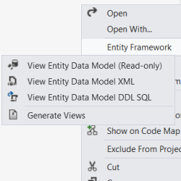

Entity Framework Power Tools Beta 4
http://bit.ly/kykTOB
Reverse Engineer
Compiled Views
THESE ARE BETA TOOLS!
Notes:
Reverse Engineer: Fluent API (ReverseEngineerExample), Data Annotations (Models.Instructor), Templating
Compiled Views: 3 seconds vs 3 minutes, DAL.SchoolContext.Views.cs
Beta Error: “The parameter is incorrect.” Must be startup project.
EF6 Note: Currently an issue with warm up times in some models.

Slide 8
Unit Tests
Testing the Data layer

Slide 9
Types of Tests
Mocking Framework
NMock, Rhino, Moq, Microsoft Fakes, etc.
Dependency Injection and Inversion of Control
Entity Framework 6
Support for mocking frameworks
Create your own test doubles
Database
Last mile testing
Performance testing
Days of .NET Sessions
A Pragmatic Intro to Unit Testing 8:00 AM Saturday, Level 100
How I Learned to Love Dependency Injection 10:20 AM Friday, Level 100
Learn the Basics: Inversion of Control 4:00 PM Friday, Level 200
TDD is about more than testing 1:40 PM Friday, Level 200
Notes:
Unit Tests > Helper (Data Initialize, Timer), Course Test Example
These are examples of how to implement, not best practices on unit test coverage.
Split out data load for: Large sets of static data (load once), into subsystems for performance.

Slide 10
Model and DAL
Auditing, Security and Performance

Slide 11
Audit Tracking
SQL Server Change Data Capture
Requires 2008+
Change Tables
Transaction Log
ETL to Data Warehouse
http://technet.microsoft.com/en-us/library/cc645937.aspx
Triggers
Common Pre- Data Capture
http://weblogs.asp.net/jgalloway/archive/2008/01/27/adding-simple-trigger-based-auditing-to-your-sql-server-database.aspx
Entity Framework
Platform Independent
Application Controlled
Basic Auditing
Historical Auditing
AuditBase Class
SaveChanges
Physical Configuration – Audit Tables
Archiving
ETL to Data Warehouse
Notes:
Windows Authentication, Web.Config (system.web, system.webserver, appsettings)
Database: Course.sql, Audit.sql
Entity Framework: Models.Audit, Models.AuditBase, DAL.SchoolContext.SaveChanges
Run: UnitTests.AuditTest.CreateStudent

Slide 12
Custom Security
Windows Authentication
Active Directory Controlled
Single Sign-On
Third-Party Controlled
Days of .NET Session
Single Sign On (SSO) using Windows Identity Foundation (WIF) in .NET 4.5 1:40 PM Saturday, Level 300
Application Security
Application Controlled
Hybrid Security Mode (Windows + DB)
Claims Based Authentication (4.5)
Custom Principal
Security Module
Anti-Forgery
Notes:
Database: Person.sql
EF: Security.CustomClaimsPrincipal
MVC: Security.SecurityModule, Web.config module section, Global.asax Application Start, Views > Instructor > Create (@Html.AntiForgeryToken()), Controllers.InstructorController.Create attributes

Slide 13
Performance Tracking
Monitoring Tools
IIS Logs
Performance Counters
Glimpse
Days of .NET Sessions
Modern Web Diagnostics with a Glimpse into ASP.NET 1:40 PM Friday, Level 200
Profiling your MVC application! 8:00 AM Friday, Level 200 (Gus Emery)
Entity Framework 5+
Lightweight, Simple, Real Stats
Performance Table
Physical Configuration – Similar to Audit
Alt: NLog (table, file, event)
Entity Framework 6
Database Logging
SQL Statements
Execution Time
http://msdn.microsoft.com/en-us/data/dn469464
Notes:
http://www.stldodn.com/2013/speakers
Database: Performance table
EF: DAL.Timer, DAL.SchoolContext.SaveChanges
Can add to repositories, page execution, etc.

Slide 14
Business Rules
Facades, Unit of Work, Repositories

Slide 15
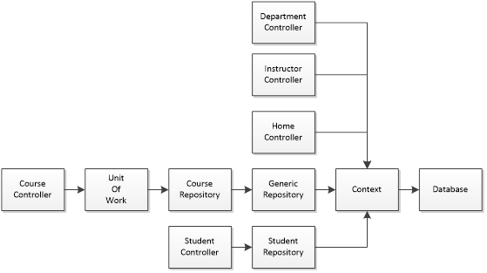
Contoso University
Notes:
Designed to demo power and flexibility.

Slide 16
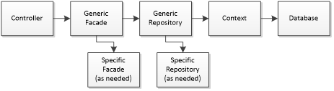
Real World Example Structure
Notes:
Uniform patterns
Extensible Points (Ex: Timer as façade layer)

Slide 17
Days of .NET Sessions
Application Architecture Jumpstart
8:00 AM Saturday, Level 200
Enterprise Architecture: Demystifying the 1,000lb Gorilla
1:40 PM Saturday, Level 200

Slide 18
More to Come
Full Article
geekswithblogs.net/scottkuhl
Real World Example
St. Louis Metro East .NET User Group, O’Fallon, IL
http://www.meetup.com/stl-east-dot-net/
oData Based Business Layer, Web API
Scott Kuhl
@scottkuhl
Source & Slides
http://sdrv.ms/1bku4ce

